Slide 1
DC Circuits
Loop (Mesh) Current Method
By Dr. Ahmed S. Abdullah
د. احمد سليمان عبدالله

Slide 2
Loop (Mesh) Current Method
Loop (mesh) analysis applies KVL to find unknown currents.
A mesh is a loop which does not contain any other loops within it.

Slide 3
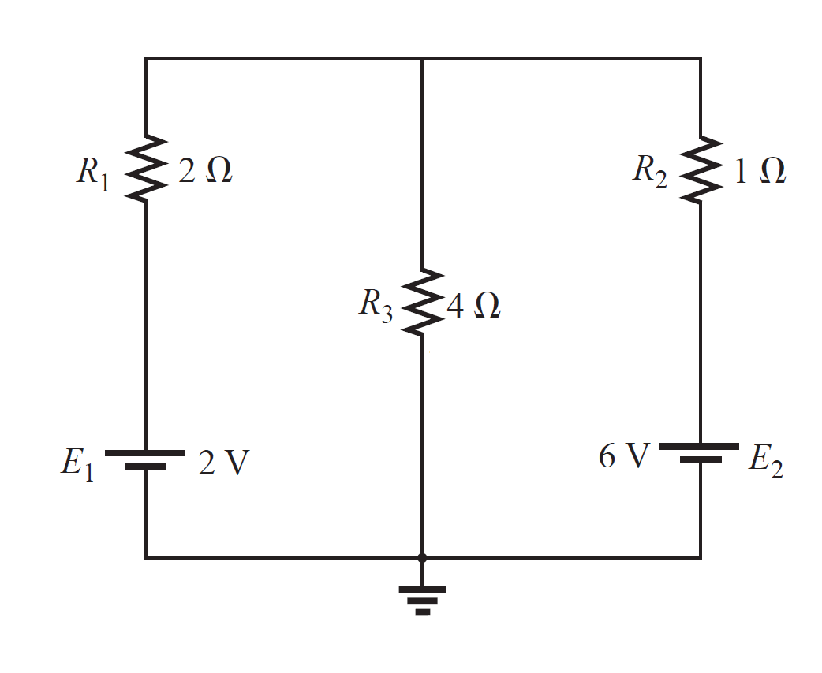
Loop (Mesh) Current Method
To illustrate the steps, consider the circuit in Figure shown.

Slide 4
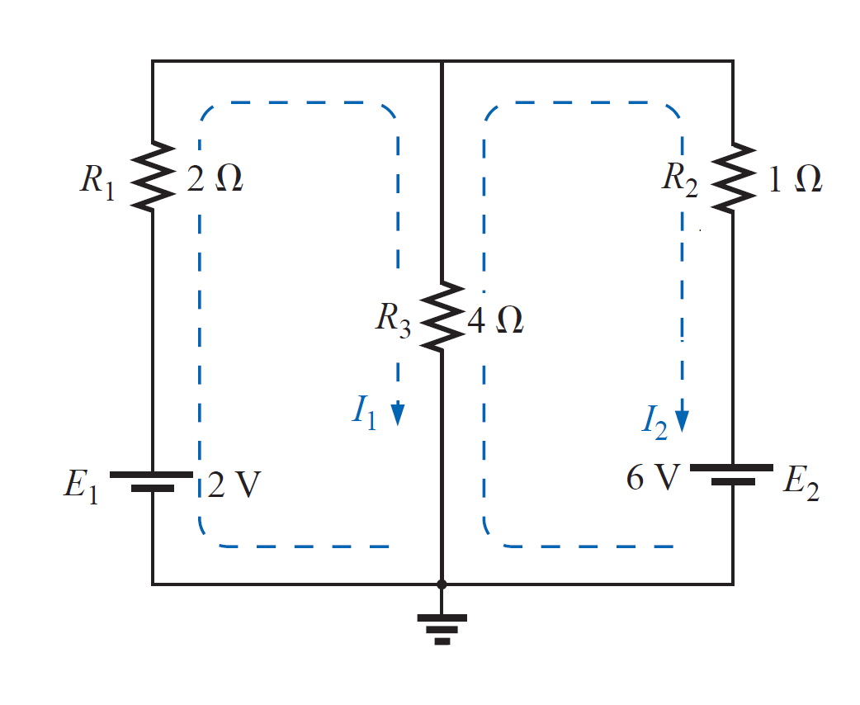
Loop (Mesh) Current Method
The first step requires that loop currents $i_{1}$ and $i_{2}$ are assigned to loops 1 and 2. Although a loop current may be assigned to each loop in an arbitrary direction, it is conventional to assume that each loop current flows clockwise.

Slide 5
Loop (Mesh) Current Method
As the second step, we apply KVL to each loop.

Slide 6
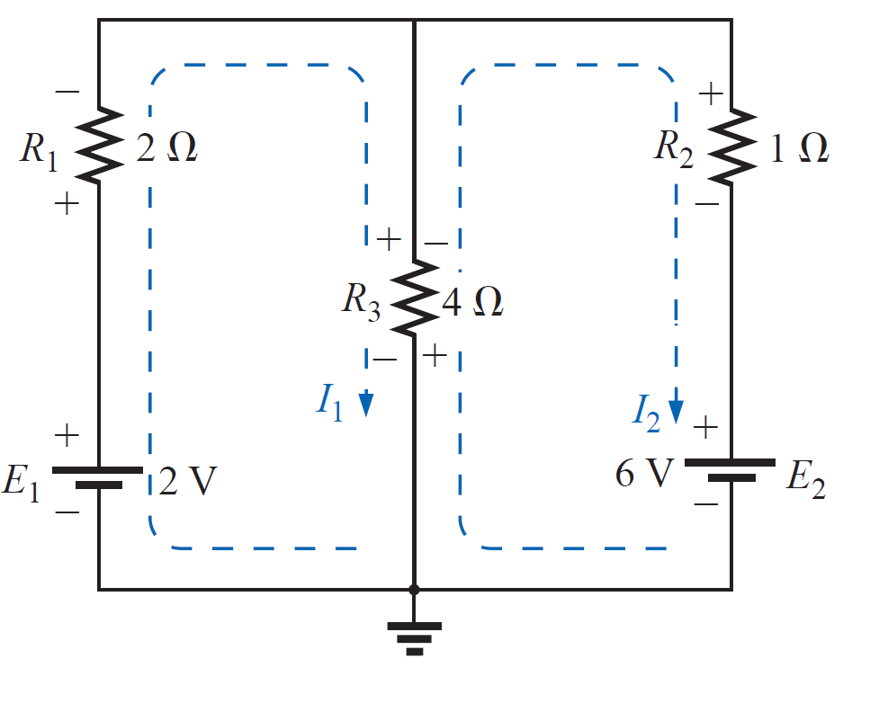
Loop (Mesh) Current Method
As the second step, we apply KVL to each loop.
Using the assigned loop currents, indicate the voltage polarities across all resistors in the circuit. For a resistor which is common to two loops, the polarities of the voltage drop due to each loop current should be indicated on the appropriate side of the component.

Slide 7
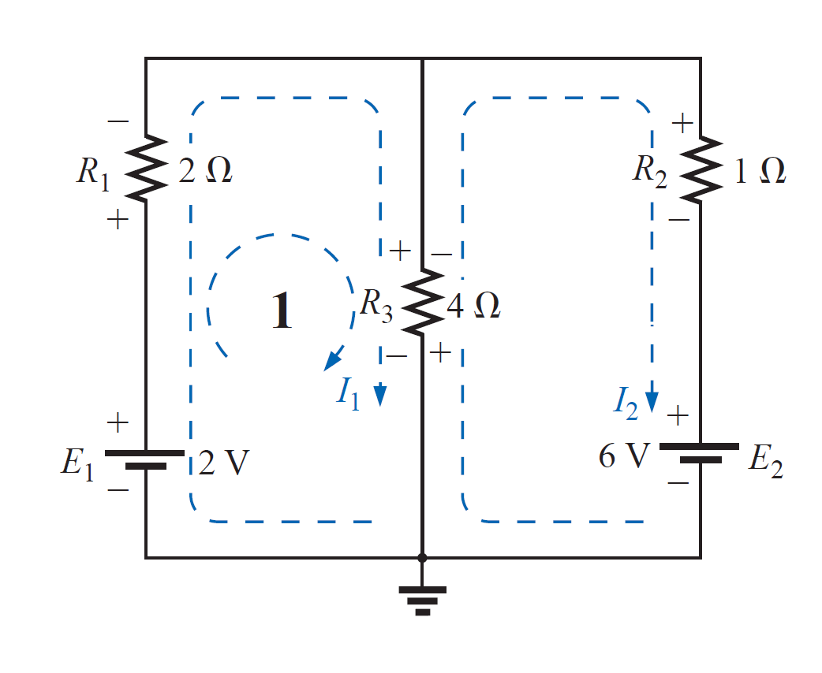
Loop (Mesh) Current Method
As the second step, we apply KVL to each loop.
Using the assigned loop currents, indicate the voltage polarities across all resistors in the circuit. For a resistor which is common to two loops, the polarities of the voltage drop due to each loop current should be indicated on the appropriate side of the component.

Slide 8
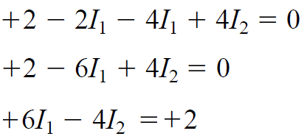
Loop (Mesh) Current Method
As the second step, we apply KVL to each loop.
Using the assigned loop currents, indicate the voltage polarities across all resistors in the circuit. For a resistor which is common to two loops, the polarities of the voltage drop due to each loop current should be indicated on the appropriate side of the component.

Slide 9
Loop (Mesh) Current Method
As the second step, we apply KVL to each loop.
Using the assigned loop currents, indicate the voltage polarities across all resistors in the circuit. For a resistor which is common to two loops, the polarities of the voltage drop due to each loop current should be indicated on the appropriate side of the component.

Slide 10
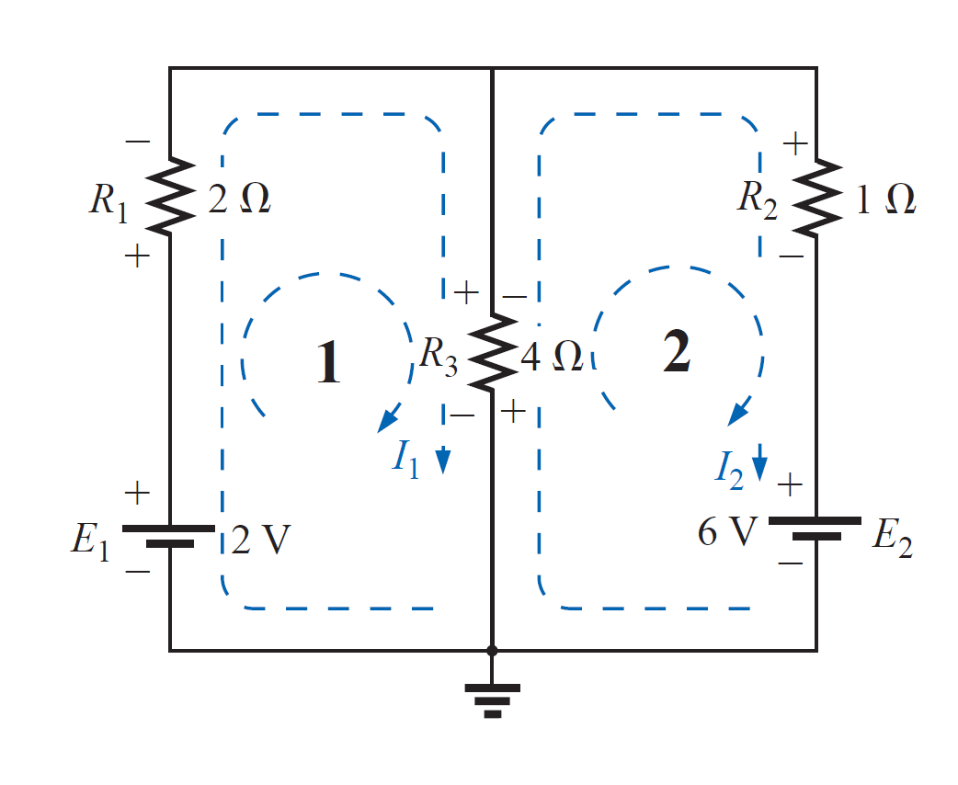
Loop (Mesh) Current Method
As the second step, we apply KVL to each loop.
Using the assigned loop currents, indicate the voltage polarities across all resistors in the circuit. For a resistor which is common to two loops, the polarities of the voltage drop due to each loop current should be indicated on the appropriate side of the component.

Slide 11
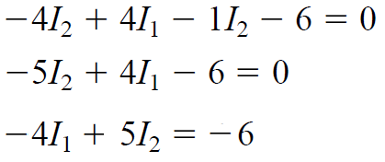
Loop (Mesh) Current Method
As the second step, we apply KVL to each loop.
Using the assigned loop currents, indicate the voltage polarities across all resistors in the circuit. For a resistor which is common to two loops, the polarities of the voltage drop due to each loop current should be indicated on the appropriate side of the component.

Slide 12
Loop (Mesh) Current Method
As the second step, we apply KVL to each loop.
Using the assigned loop currents, indicate the voltage polarities across all resistors in the circuit. For a resistor which is common to two loops, the polarities of the voltage drop due to each loop current should be indicated on the appropriate side of the component.

Slide 13
Loop (Mesh) Current Method
As the second step, we apply KVL to each loop.
Using the assigned loop currents, indicate the voltage polarities across all resistors in the circuit. For a resistor which is common to two loops, the polarities of the voltage drop due to each loop current should be indicated on the appropriate side of the component.

Slide 14
Loop (Mesh) Current Method
The third step is to solve for the loop currents.
Solve the resultant simultaneous linear equations by the determinants method.

Slide 15
Loop (Mesh) Current Method
The third step is to solve for the loop currents.
Solve the resultant simultaneous linear equations by the determinants method.
$$∆ =\left|\begin{matrix}+6 & −4 \\ −4 & +5\end{matrix}\right|=\left(6)(5\right)−\left(−4\right)\left(−4\right)=30−16=+14$$
$$∆1=\left|\begin{matrix}+2 & −4 \\ −6 & +5\end{matrix}\right|=\left(2)(5\right)−\left(−4\right)\left(−6\right)=10−24=−14$$
$$∆2=\left|\begin{matrix}+6 & +2 \\ −4 & −6\end{matrix}\right|=\left(6)(−6\right)−\left(2\right)\left(−4\right)=−36+8=−28$$
$$∴I_{1}=\frac{∆1}{∆}=\frac{−14}{+14}=−1 A$$
$$and I_{2}=\frac{∆2}{∆}=\frac{−28}{+14}=−2 A$$
The minus signs indicate that the currents have a direction opposite to that indicated by the assumed loop current.

Slide 16
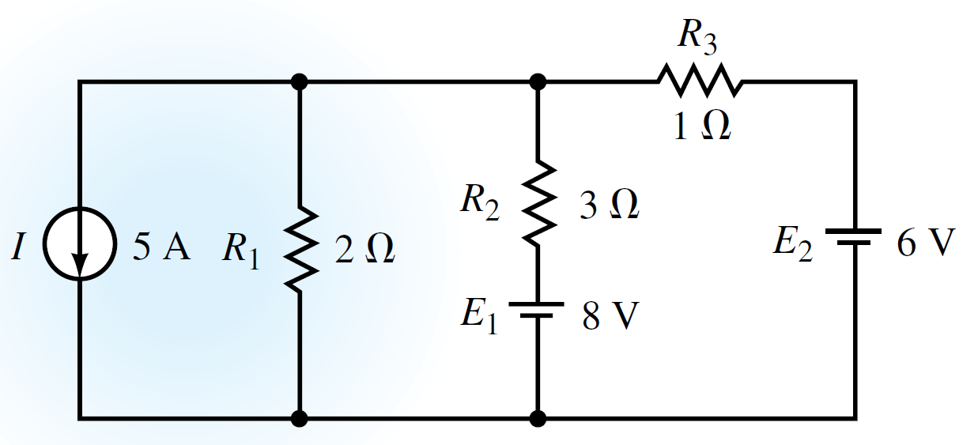
Loop (Mesh) Current Method
EXAMPLE Determine the current through the 8-V battery for the circuit of Figure shown.

Slide 17
Loop (Mesh) Current Method
EXAMPLE Determine the current through the 8-V battery for the circuit of Figure shown.
Solution Convert the current source into an equivalent voltage source.

Slide 18
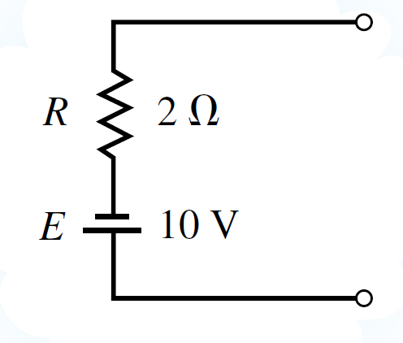
Loop (Mesh) Current Method
EXAMPLE Determine the current through the 8-V battery for the circuit of Figure shown.
Solution Convert the current source into an equivalent voltage source.
$$E=IR_{1}=5×2=10 V$$

Slide 19
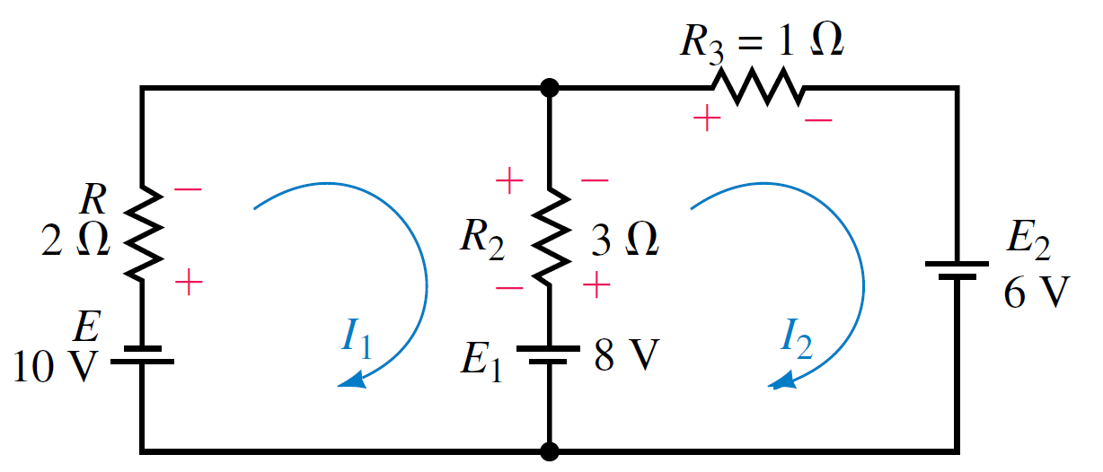
Loop (Mesh) Current Method
EXAMPLE Determine the current through the 8-V battery for the circuit of Figure shown.
Solution The equivalent circuit may now be analyzed by using the loop currents.

Slide 20
Loop (Mesh) Current Method
EXAMPLE Determine the current through the 8-V battery for the circuit of Figure shown.
Solution

Slide 21
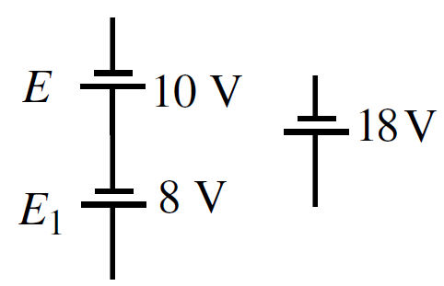
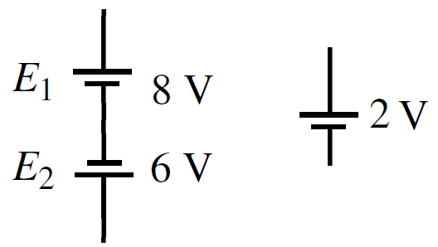
Loop (Mesh) Current Method
EXAMPLE Determine the current through the 8-V battery for the circuit of Figure shown.
Solution
Rewriting the linear equations, you get the following:

Slide 22
Loop (Mesh) Current Method
EXAMPLE Determine the current through the 8-V battery for the circuit of Figure shown.
Solution
Rewriting the linear equations, you get the following:
Solving the equations using determinants, we have the following:
$$∆=\left|\begin{matrix}+5 & −3 \\ −3 & +4\end{matrix}\right|=\left(5)(4\right)−\left(−3\right)\left(−3\right)=20−9=+11$$
$$∆1=\left|\begin{matrix}−18 & −3 \\ +2 & +4\end{matrix}\right|=\left(−18)(4\right)−\left(−3\right)\left(+4\right)=−72+6=−66$$
$$∆2=\left|\begin{matrix}+5 & −18 \\ −3 & +2\end{matrix}\right|=\left(5)(2\right)−\left(−18\right)\left(−3\right)=10−54=−44$$

Slide 23
Loop (Mesh) Current Method
EXAMPLE Determine the current through the 8-V battery for the circuit of Figure shown.
Solution
$$∴I_{1}=\frac{∆1}{∆}=\frac{−66}{+11}=−6 A$$
$$and I_{2}=\frac{∆2}{∆}=\frac{−44}{+11}=−4 A$$
If the assumed direction of current in the 8-V battery is taken to be I2, then
$$I_{8V}=I_{2} − I_{1}$$
$$I_{8V}$$
$$I_{1}$$
$$I_{2}$$
$$= −4 −\left(−6\right)=2 A$$
The direction of the resultant current is the same as I2 (upward).

Slide 24
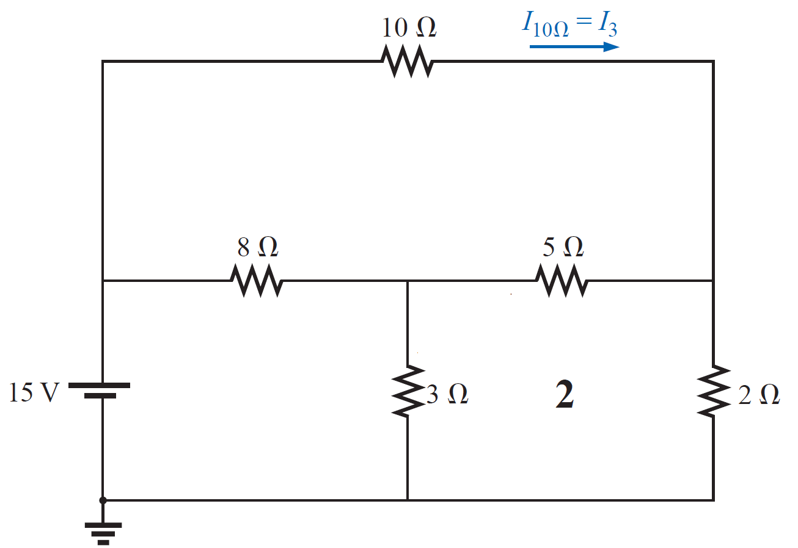
Loop (Mesh) Current Method
EXAMPLE Find the current through the 10 Ω resistor for the circuit of Figure shown.

Slide 25
Loop (Mesh) Current Method
EXAMPLE Find the current through the 10 Ω resistor for the circuit of Figure shown.

Slide 26
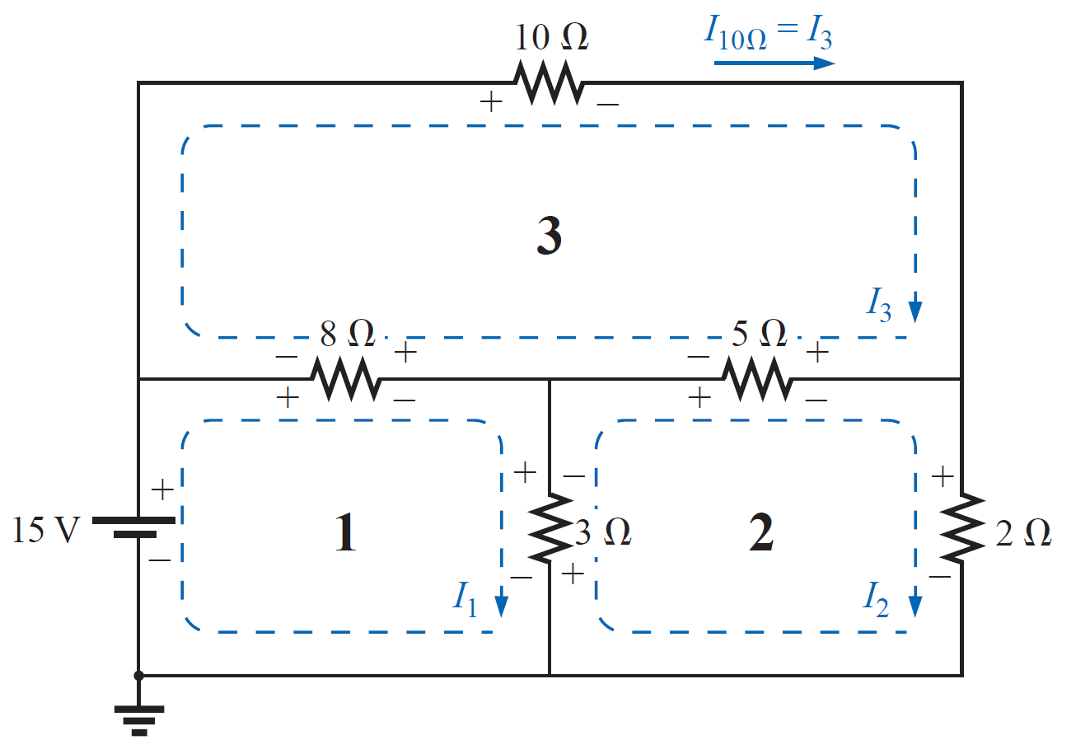
Loop (Mesh) Current Method
EXAMPLE Find the current through the 10 Ω resistor for the circuit of Figure shown.
Solution
The loop equations are:-
Loop 1:$\left(8+3\right)I_{1}−3I_{2}−8I_{3}=15$
Loop 2:$(3+5+2)I_{2}−3I_{1}−5I_{3}=0$
Loop 3:$(5+8+10)I_{3}−8I_{1}−5I_{2}=0$

Slide 27
Loop (Mesh) Current Method
EXAMPLE Find the current through the 10 Ω resistor for the circuit of Figure shown.
Solution
The loop equations are:-
Loop 1:$\left(8+3\right)I_{1}−3I_{2}−8I_{3}=15$
Loop 2:$(3+5+2)I_{2}−3I_{1}−5I_{3}=0$
Loop 3:$(5+8+10)I_{3}−8I_{1}−5I_{2}=0$
Rearrange, then:
Loop 1:$11I_{1}− 3I_{2}− 8I_{3}=15$
Loop 2:$−3I_{1}+10I_{2}− 5I_{3}=0$
Loop 3:$−8I_{1}− 5I_{2}+23I_{3}=0$

Slide 28
Loop (Mesh) Current Method
EXAMPLE Find the current through the 10 Ω resistor for the circuit of Figure shown.
Solution
Loop 1:$11I_{1}− 3I_{2}− 8I_{3}=15$
Loop 2:$−3I_{1}+10I_{2}− 5I_{3}=0$
Loop 3:$−8I_{1}− 5I_{2}+23I_{3}=0$
$∆=\left|\begin{matrix}+11 & −3 & −8 \\ −3 & +10 & −5 \\ −8 & −5 & +23\end{matrix}\right|$= 1168
$∆_{3}=\left|\begin{matrix}+11 & −3 & +15 \\ −3 & +10 & 0 \\ −8 & −5 & 0\end{matrix}\right|$= 1425
$$∴I_{3}=\frac{∆3}{∆}=\frac{1425}{1168}=1.22 A$$
$$∴I_{3}=I_{10Ω}=1.22 A$$

Slide 29
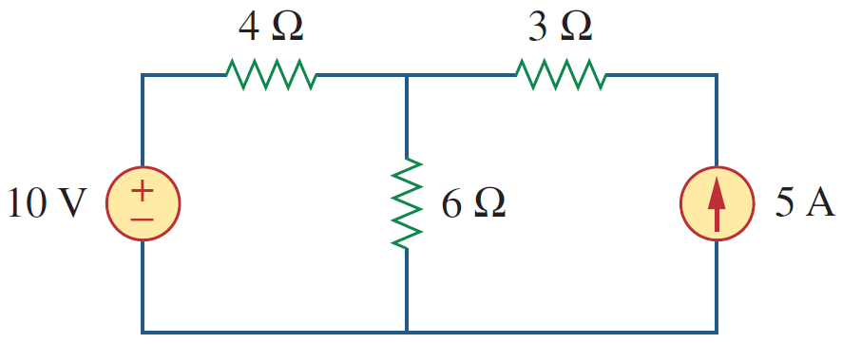
Mesh Analysis with Current Sources
Special cases
CASE 1 When a current source exists only in one mesh:
Consider the circuit in Figure shown,

Slide 30
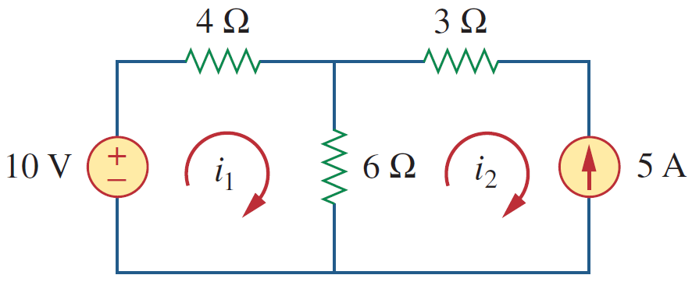
Mesh Analysis with Current Sources
Special cases
CASE 1 When a current source exists only in one mesh:
Consider the circuit in Figure shown, for example. We set $i_{2}=−5 A$ and write a loop equation for the other loop in the usual way; that is,
Loop 2:$I_{2}=−5$
Loop 1:$\left(4+6\right)I_{1}−6I_{2}=10$
Rearrange, then:
Loop 2:$I_{2}=−5$
Loop 1:$10I_{1}−6I_{2}=10$
$$10I_{1}−6(−5)=10$$
$$I_{1}=\frac{10−30}{10}=−2 A$$

Slide 31
References
Boylestad, Robert L. Introductory circuit analysis. Pearson Education, 2010.
Robbins, Allan H., and Wilhelm C. Miller. Circuit analysis: Theory and practice. Cengage Learning, 2012.
Sadiku, Matthew NO, and Chales K. Alexander. Fundamentals of electric circuits. McGraw-Hill Higher Education, 2007.

